Slide 1
Customer Churn Prediction Model - Prioritising Retention Outreach with Machine Learning
Jack Kelly | 17th March

Slide 2
Business Problem & Objective
Context: Retention is a strategic priority for the upcoming year
Problem: Contacting all customers is inefficient and expensive
Goal: Identify the right customers to call, those most likely to leave
Output: A ranked, scored list of at-risk customers for the retention team

Slide 3
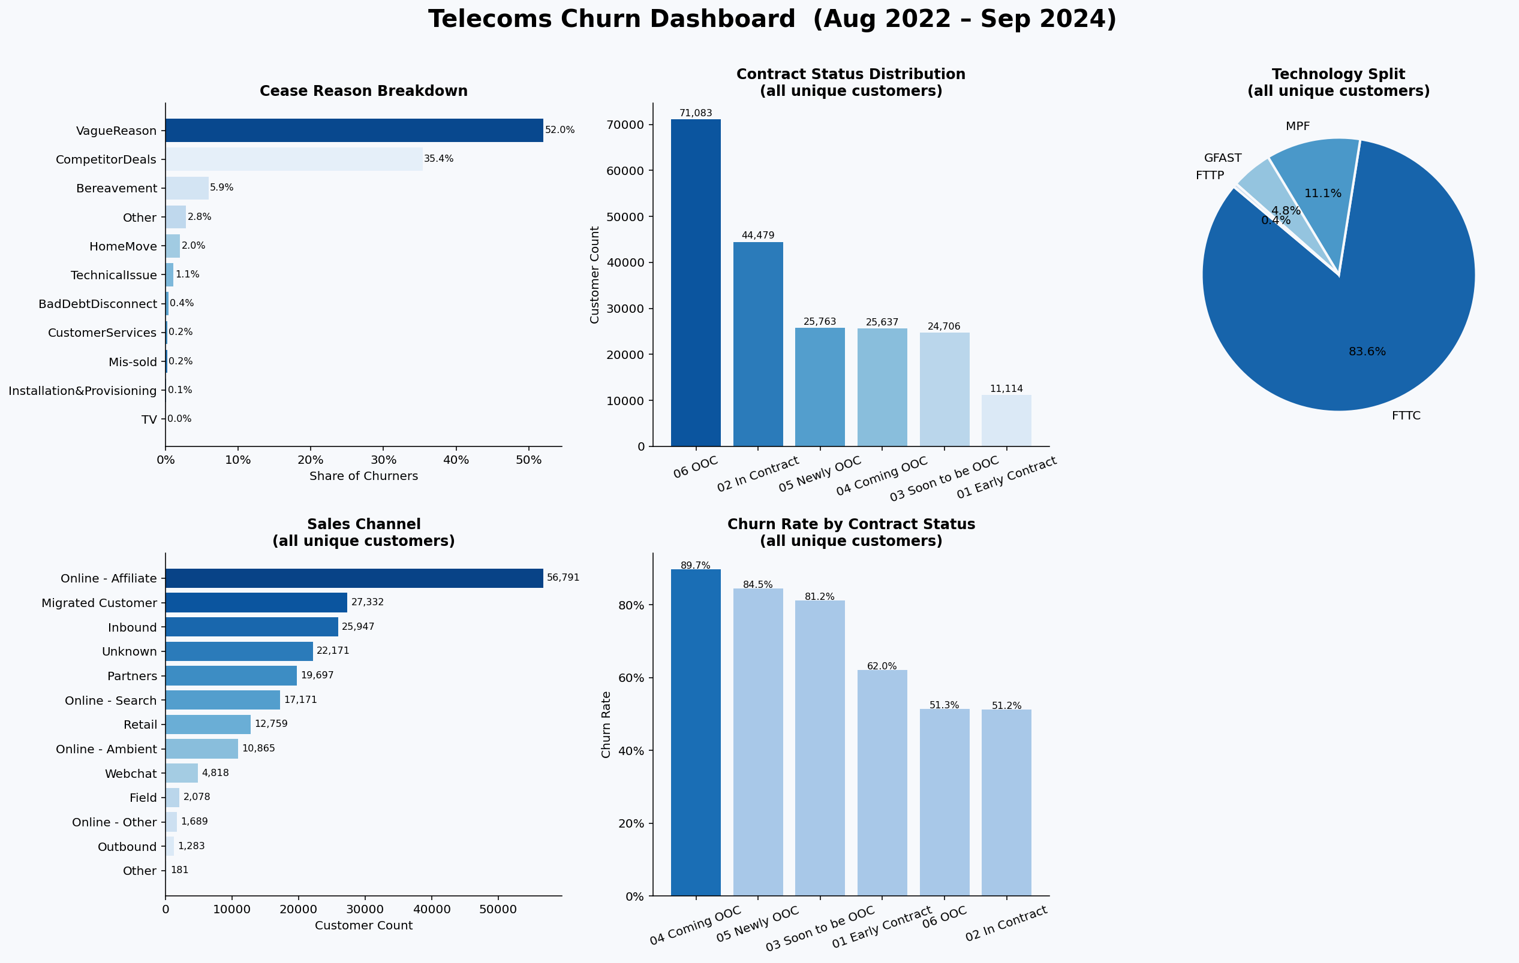
Notes:
Data leakage if used to make any decisions with the modelling later

Slide 4
Data Overview
Active customer data being monthly allows us to format the problem statement as ‘based on the last 30 days of behavior, who is going to churn in the next 30 days?’
Data sources
customer_df
Active customers by month
usage_df
Daily broadband usage
-30 days
Generate user behaviour
+ 30 days
Will user churn?
calls_df
Call centre events
cease_df
Cancellation records
Date of prediction
Customer level features
Gap between customer purchased speed tier and actual line speed
Speed attainment below 70%
Flags for end of contract near
Length on contract
Call centre features
Call types by volume and type
Hold to talk in call ratio
Changes in call length and amount over time
Usage features
Download and upload activity levels
Trend in downloads
Recency of usage and number of days when not using
Generate set of 60 features that include the following for each month

Slide 5
Modelling Approach
Data is into training (Sept 2022- Dec 2023) and test (Feb 2024 – Aug 2024)
There is a 1 month gap of data between the train and test to ensure no data leakage between the two.
This leaves 2,298,139 rows in the training and 503,866 rows in the test data
There is a 3.8% churn rate in the training and 4.4% in test
XGBoost (gradient boosted trees)
handles mixed data types, class imbalance, non-linear relationships, interpretable with SHAP
The class imbalance is the hardest technical problem in this case:
Regularisation within model
Increase weight of incorrect classification of minority class within model learning
Small amount of undersampling of very similar data points using nearest neighbours
Hyperparameters within the model based on experience with similar data
Limit complication of model through number of estimators and tree depth

Slide 6
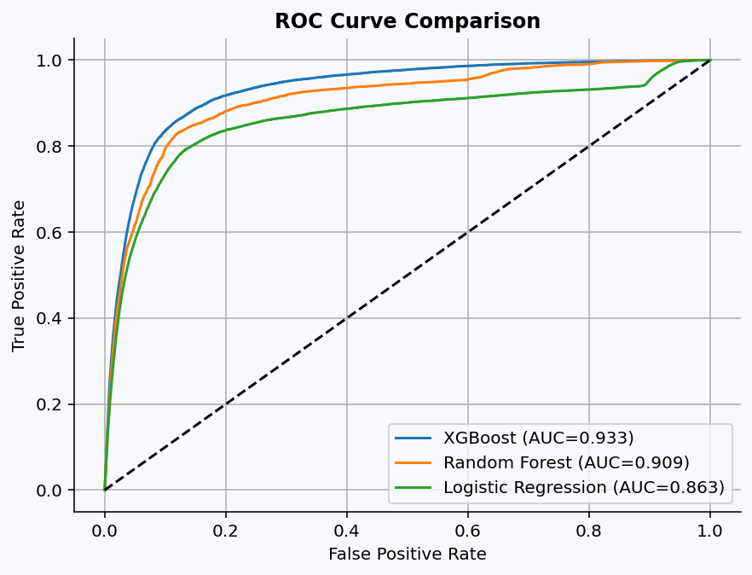
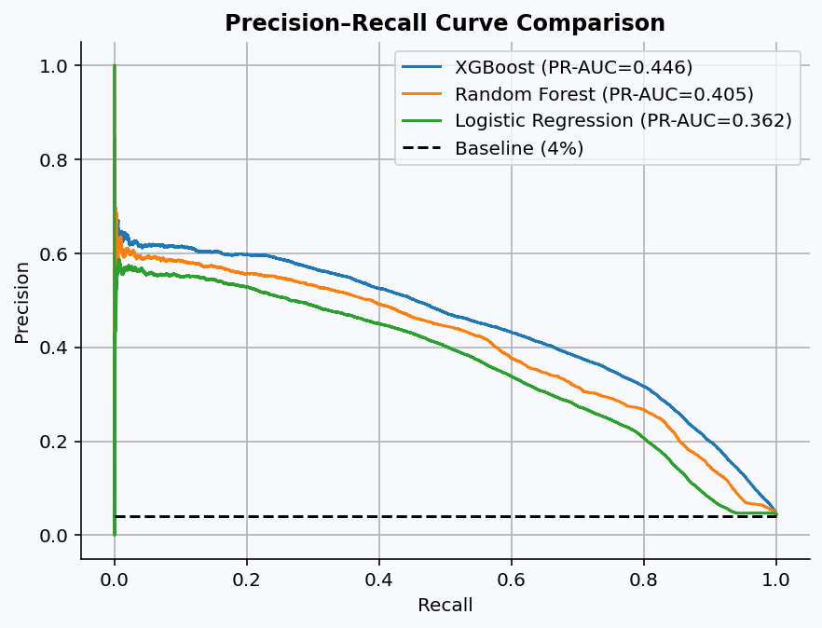
Model Performance
XGBoost performs strongly with ROC AUC of 0.93
The precision recall curve also shows that despite the high-class imbalance the model can identify users that will churn

Slide 7
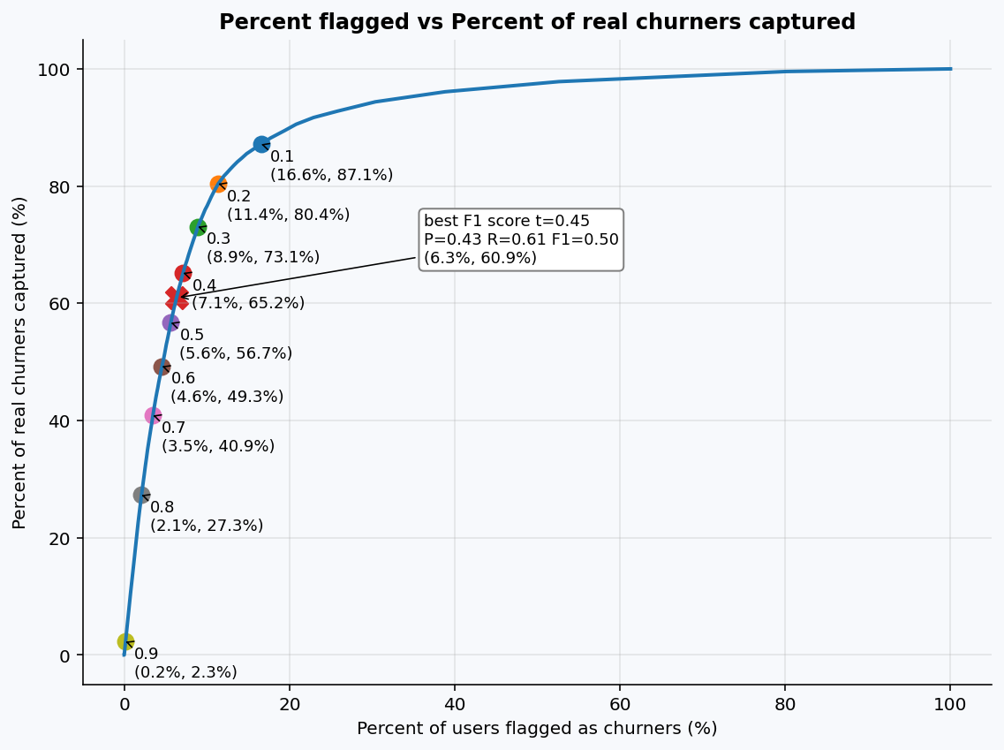
Business Targeting
The best threshold for classing someone as a churn risk is also an operational problem
Identify the optimal trade off between % of users intervened and percent of churning users identified (recall) using approaches like maximizing F1 score

Slide 8
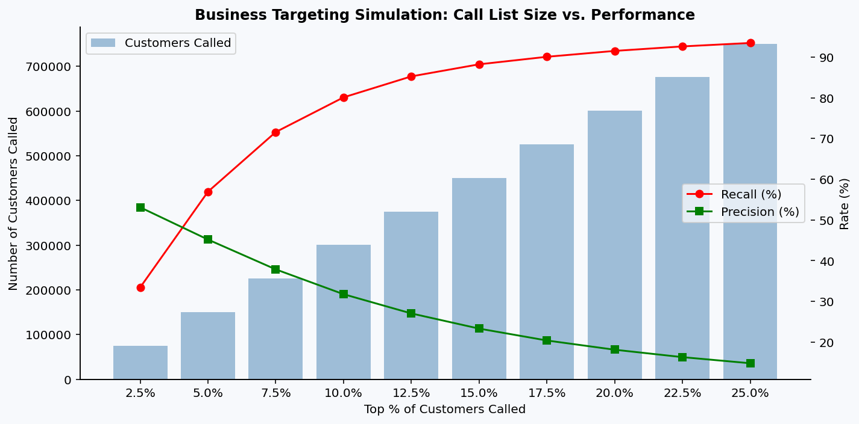
How many people can we contact within a space of time?
Eg. At bet365 we could contact ~5% of the user base, so the classification problem used custom metrics that identified as many possible self-excluders within the top 5% of probabilities

Slide 9
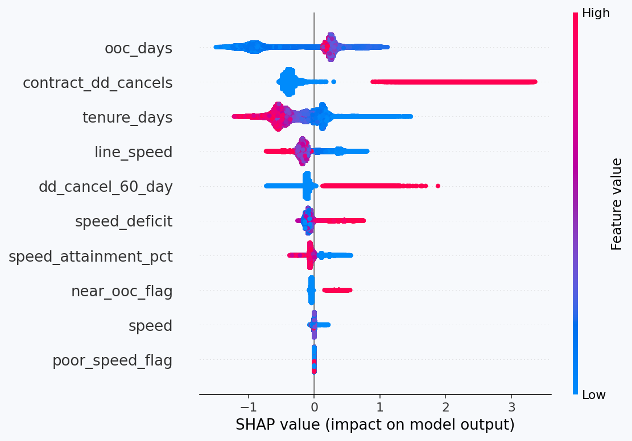
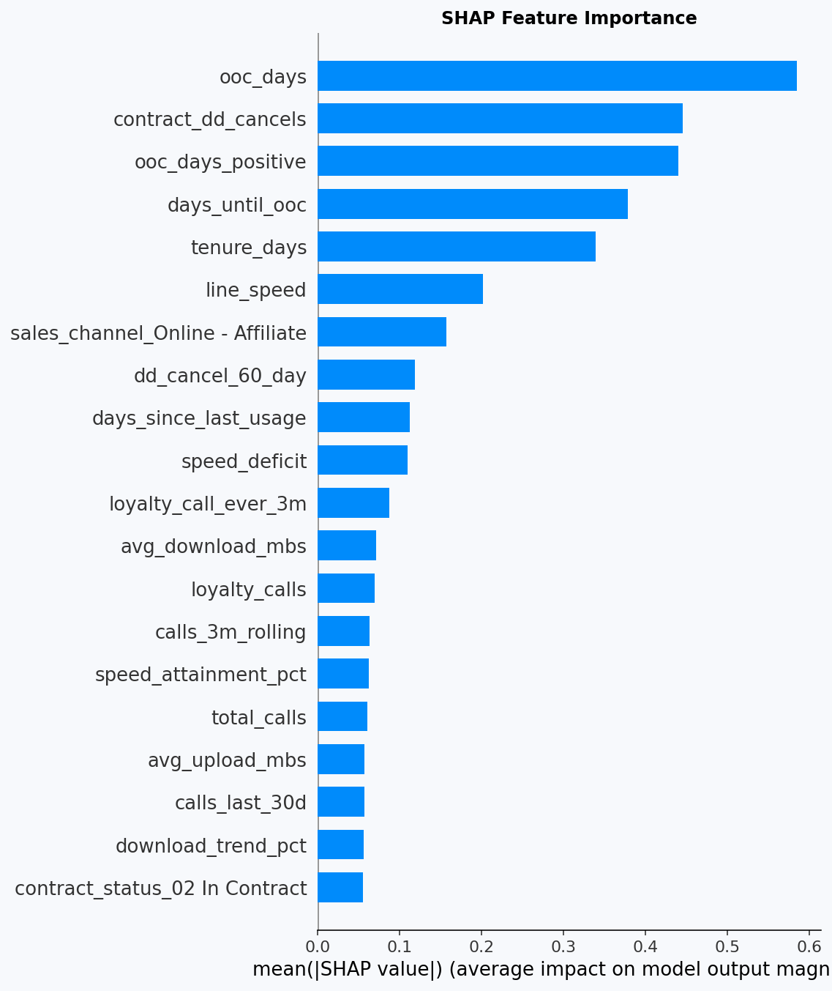
What Drives Churn?
SHAP shows a type of importance for features within the model, so we can see what the model is using to predict churn
Customer with lots of days left on their contract are less likely to churn.
High direct debit cancellations increase likelihood to churn
Those who have been with UK telecoms ltd. for longer are less likely to churn
Low line speed and a deficit between real and contracted speed impact churn likelihood.
These are the features that impact the models predictions and cannot be said to the cause of churn

Slide 10
Recommendations + next steps
This projects returns the deliverable of a scored customer list with probability of churn over the next 30 days
Priorities who to contact - High risk can be immediately outreached to
Risk tiers can be created and tracked over time.
Next steps in production:
A/B test: model-targeted calls vs. random sample to measure retention uplift
Retrain monthly with new data
Add complaint/fault data as additional signal
Consider a real-time scoring API for the CRM

Slide 11
Changes to approach with more time
Exploration different churn models (historics period and churn period)
Hyperparameter tuning (Optuna)
Feature reduction
Time-series cross-validation (avoid data leakage across months)
Survival analysis (time-to-churn modelling)
Segment-specific models (using different products)
Customer lifetime value weighting (prioritise high-value at-risk customers)

